Slide 1
Latest knowledge on the epidemiology of African swine fever in Hungary
University of Veterinary Medicine
Budapest
16.09.2025.
Zsolt Földi DVM
Head of National CSF and ASF Expert Group
Notes:
I am glad to be here and to talk to you about this topic.

Slide 2
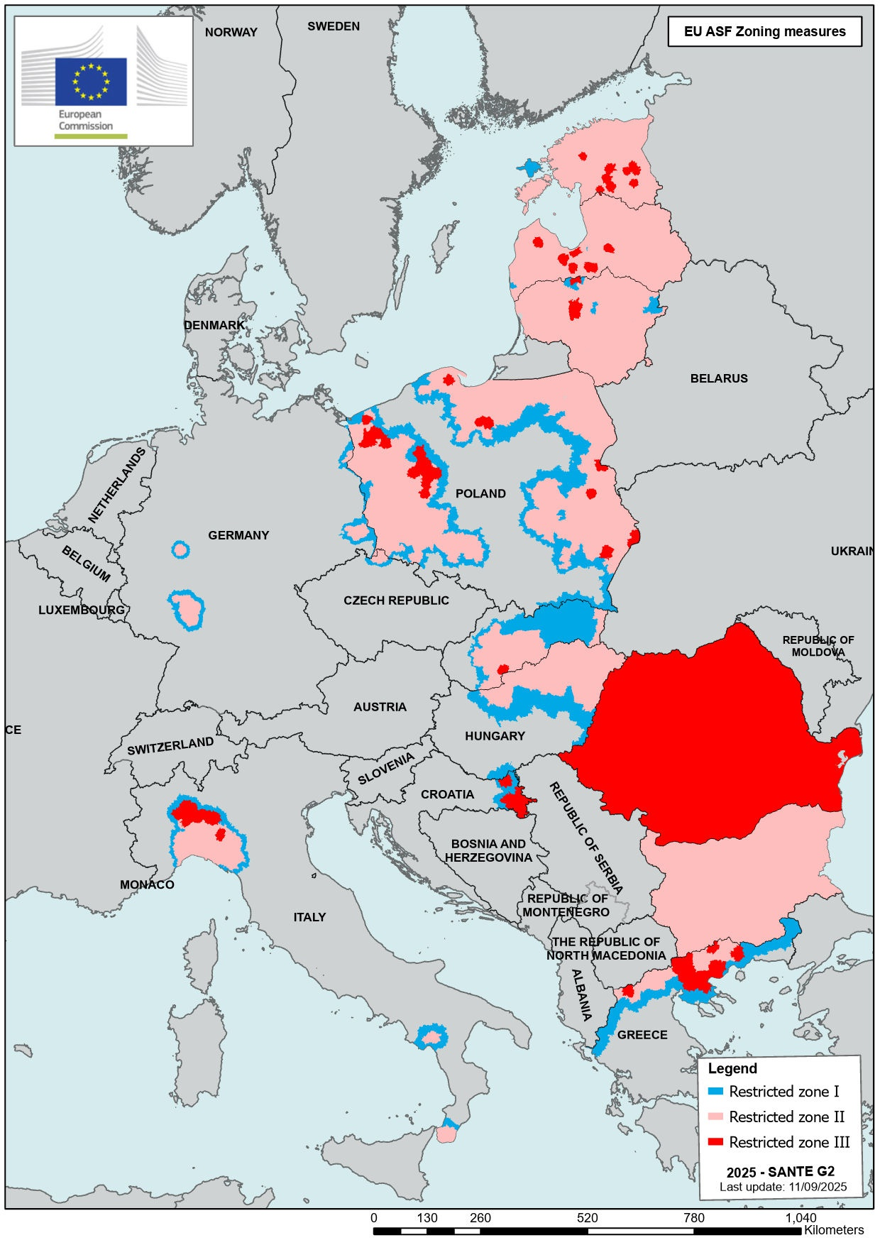
Restricted areas in the EU due to ASF
Notes:
Red= ASF occours WB & domestic pigs, pink = ASF occours only in WB, blue = high risk are between the infected and the free area

Slide 3
The start of professional work based on risk analysis
The CVO established the ASF Risk Analysis Working Group in September 2017 on the recommendation of the National CSF and ASF Expert Group.
At that time, Hungary was free of the disease, but ASF was present in the Transcarpathian region of neighbouring Ukraine.
Since the working group had a relatively large number of experts, they established the principles and the ASF Risk Analysis Action Group was created within the working group in order to work efficiently.

Slide 4
The Hungarian ASF risk analysis system is established
In early February 2018, the Action Group formulated a detailed proposal on
- identifying the risk of the introduction of ASF to the country and
the determination of areas of the country with high, medium and low ASF risk, since the disease was not yet present, there was no extremely high risk (infected) area.
This proposal led to the creation of the ASF risk analysis system, which is still in use today.

Slide 5
ASF risk analysis – practical implementation 1.
First level
We use an own algorithm running in an R software environment to identify extremely high risk (infected), high risk and medium risk hunting (game) management units (the low risk area classification was discontinued following the proposal of the National Expert Group meeting in December 2019).
The algorithm defines these areas based on the density of wild boars in the game management units (GMUs) and the distance of the GMUs from the wild boar cases in Hungary, as well as the distance from outbreaks of wild boars in neighboring countries within a 20 km zone from the Hungarian border.
In the case of foreign cases, the distance of 20 km from the border was determined based on an analysis of the distances between cases identified in the Zlínský region of the Czech Republic in 2017. The maximum distance between two cases there was 16 km. Rounding this up gives us 20 km.
• For interactive visualisation we use QGIS software

Slide 6
ASF risk analysis – practical implementation 2.
Second level
The National Expert Group will make the final decision taking into account other important factors such as effective natural and artificial barriers, epidemiological information, in particular the geographical location of new cases in relation to previous cases, the distance of new cases from the boundary of the infected and high risk area
Update
We updated the risk analysis for any significant change in the epidemiological situation
Modification of the system
If justified by practical experience

Slide 7
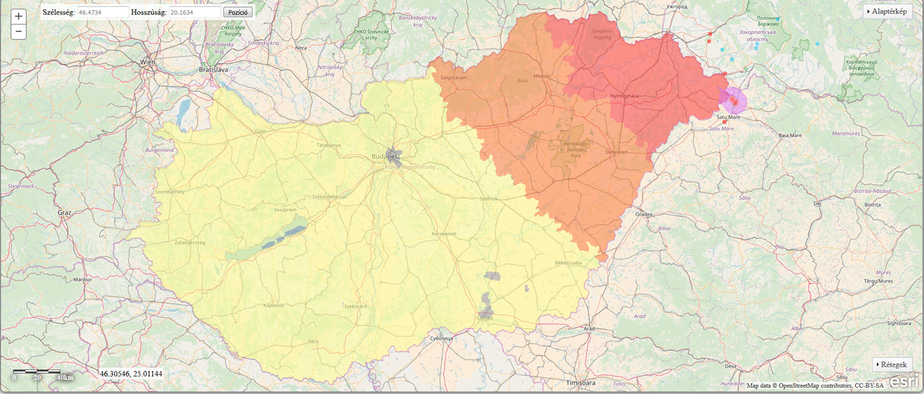
ASF risk areas in February 2018

Slide 8
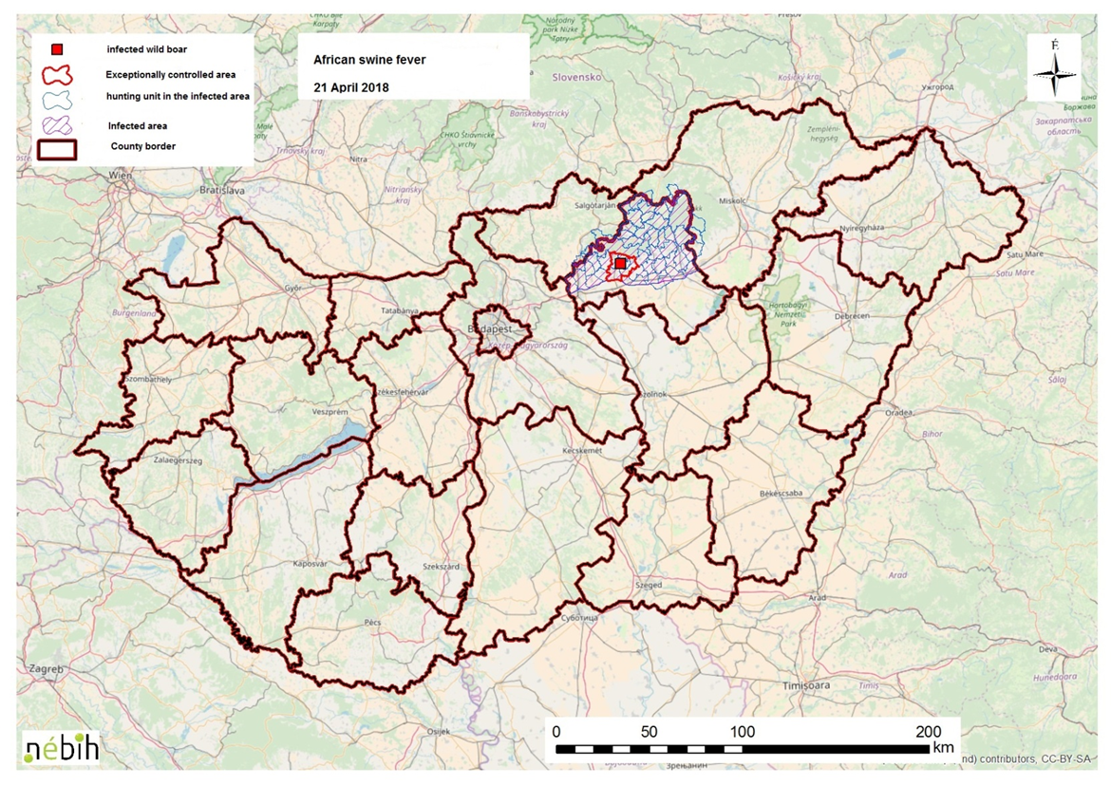
The first ASF case in Hungary – 21.04.2018.

Slide 9
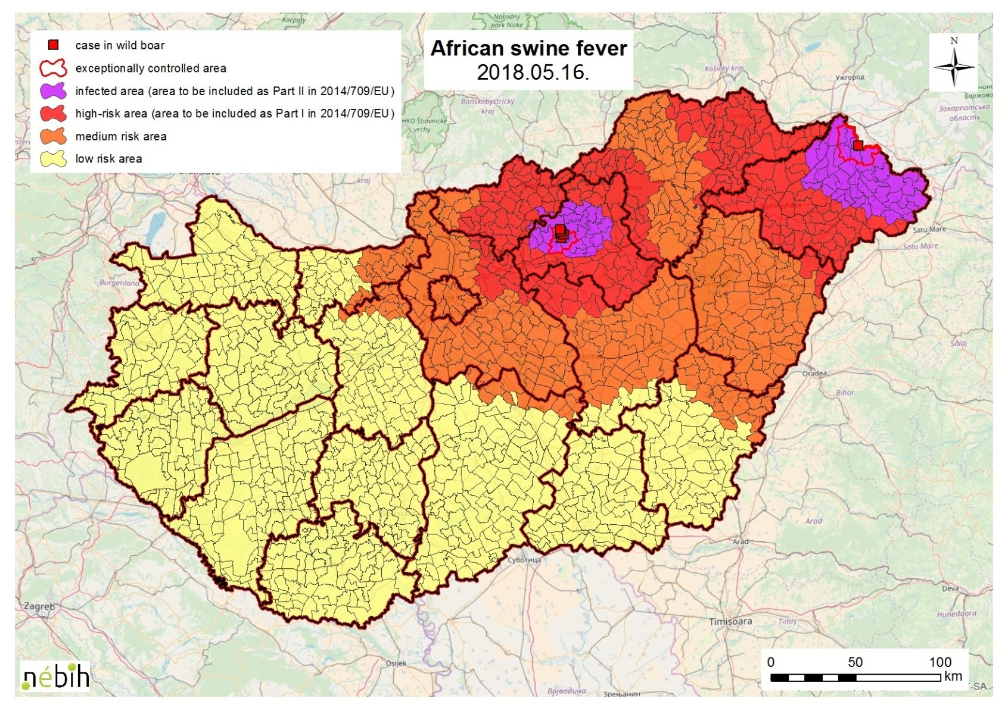
Official ASF risk areas after the infection of Szabolcs-Szatmár-Bereg County (May 16, 2018)

Slide 10
ASF risk analysis – practical implementation 3.
The most important modifications of the risk analysis system
In 19 July 2021 it has been proposed that administrative decisions should then be based on a risk analysis taking into account cases within one year (last year). It was preceded by a comprehensive retrospective study. It was necessary because we had taken into account all the cases that had occurred until then, so the risk would never have decreased or disappeared.
In 17 August 2022 the existing risk analysis has been supplemented with a second step, in the case of hunting management units that could be reclassified from extremely high risk to high risk based on the first (original) step.

Slide 11
Adding a new second step to the ASF risk analysis 1.
In the 2022/2023 hunting year, there was a few occasions within the infected area where the distance between a new case and the nearest case within one year was much greater than usual (large jumps of at least 20 km).
This could be a problem if the ASF risk of game management units close to such a new case had decreased prior to the big jump, and therefore during the first step a proposal was made to reclassify these units from infected to high risk.

Slide 12
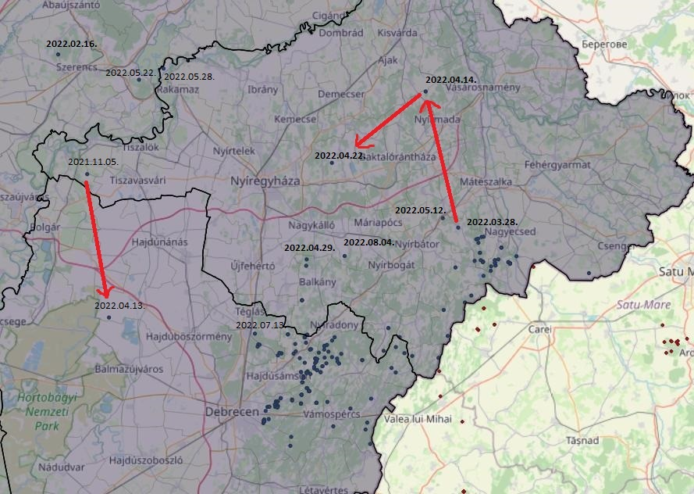
Map - Cases with a big jump

Slide 13
Adding a new second step to the ASF risk analysis 2.
After a comprehensive analysis, the Risk Analysis Action Group decided to add a second step to the current risk analysis system, where the algorithm examines whether cases within one year have occurred within 30 km radius of the border of the units proposed to be reclassified (in the first step of analysis) from the infected area (from extremely high risk) to high risk. If yes, the infected (extremely high risk) area remains the classification of these units.
This procedure provides more reliability than before for possible area reductions, while at the same time providing an appropriate level of risk reduction for this risk analysis.

Slide 14
The effectiveness of ASF risk analysis so far
The effectiveness of the risk analysis is well characterized by the fact that 99.9 percent of all ASF cases confirmed in wild boars in Hungary until 12. September 2025 were found within the infected area.
Moreover, from January 1, 2021, all confirmed wilde boar cases occurred within the infected area.
So we have improved this already extremely effective system even further by introducing the second step mentionded earlier.

Slide 15
Proposal of the National Expert Group on 15 September 2022 and changes to the official risk areas from 27 June 2023
At its meeting on 15 September 2022, the National Expert Group, after analysing the risk analysis, the epidemiological situation and the negative PCR results, recommended the followings:
Reduction of the infected area in Jász-Nagykun-Szolnok and Békés counties (+ 1 hunting (game) management unit in Pest county adjacent to JNK county)
Reduction of the high risk area in the counties of Bács-Kiskun, Békés, Csongrád-Csanád and Jász-Nagykun-Szolnok
The proposal was finally adopted in Brussels in June 2023 and it entered into force on 27 June 2023

Slide 16
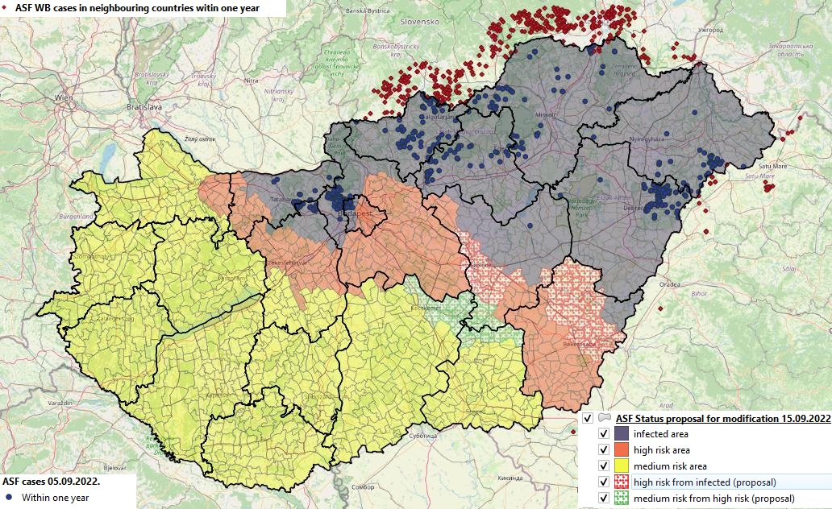
Proposal of the National Expert Group on 15 September 2022 - national overview map

Slide 17
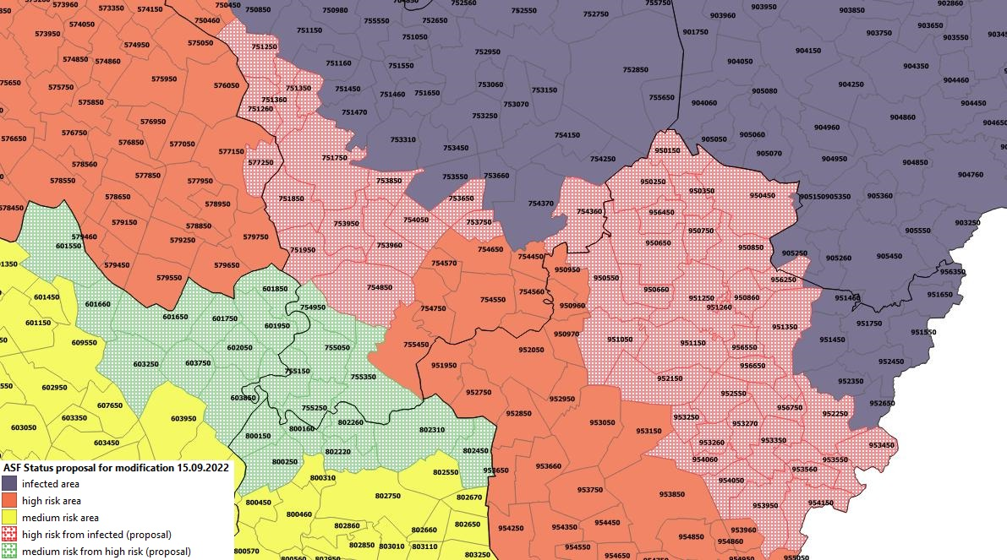
Proposal of the National Expert Group on 15 September 2022 – closer map

Slide 18
Proposals from the National Expert Group between June 2023 and March 2024, to further reduce official risk areas
At its meetings held between June 2023 and March 2024, the National Expert Group, after analysing the risk analysis, the epidemiological situation and the negative PCR results, recommended
Reduction of the infected area in Jász-Nagykun-Szolnok and Békés counties
Reduction of the high risk area in the counties of Békés, Jász-Nagykun-Szolnok and Pest
At the request of the EU Commission, the original proposal had to be amended in Békés County so that it would remain a high-risk area along the Romanian border.
The proposal was finally accepted in Brussels and came into force on 25 September 2024.

Slide 19
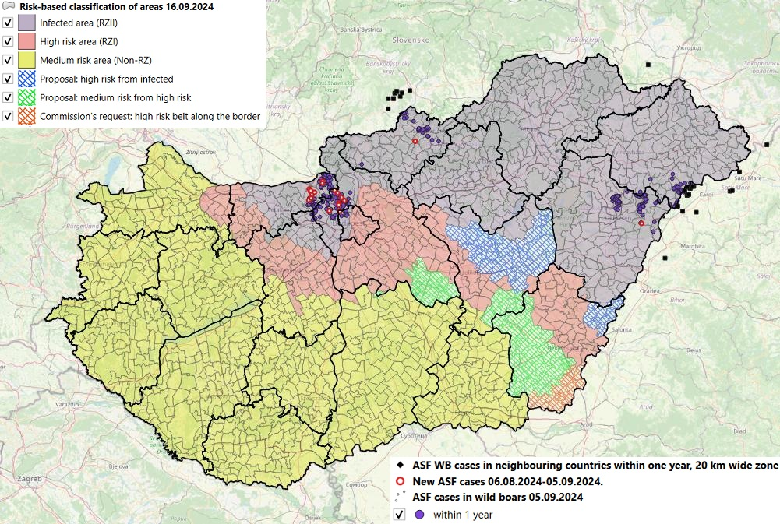
Proposals from the National Expert Group 2023-2024. – national overview map

Slide 20
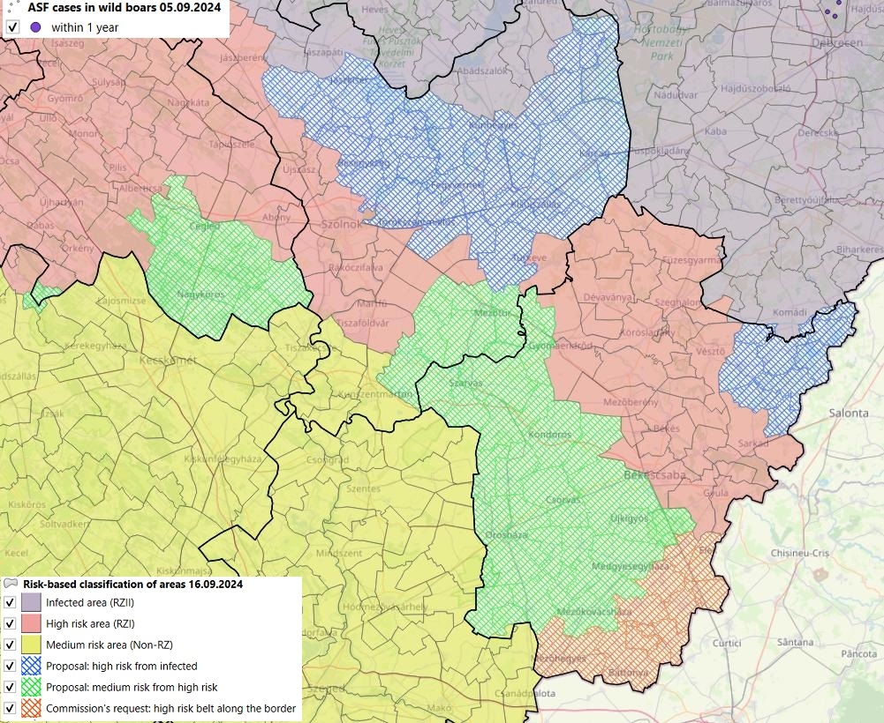
Proposals from the National Expert Group 2023-2024. – close map

Slide 21
Creation of a high-risk area in Baranya County near the Croatian border based on the recommendation of the National Expert Group on July 29, 2025.
During the week beginning 21 July, Croatians detected two ASF outbreaks in wild boars near the Hungarian border, the first about 7.5 km and the second about 10 km from the border.
Both confirmed outbreaks in wild boars occurred within a 20 km zone from the Hungarian border, so these are affecting the Hungarian ASF risk assessment.
Due to the confirmed outbreaks in Croatia, the National Expert Group recommended the establishment of a high-risk area along the Croatian border, as shown on the following map.

Slide 22
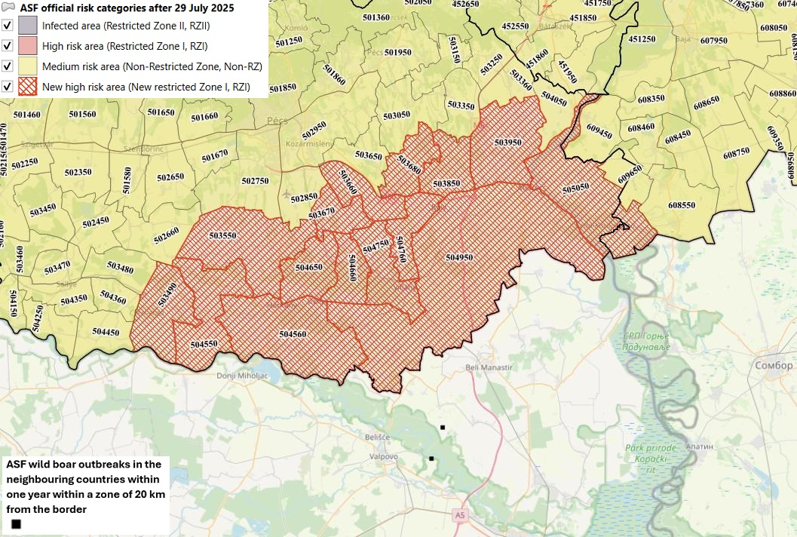
Proposal from the National Expert Group on 29 July 2025. – close map

Slide 23
Surveillance system in general
The surveillance system is designed to detect diseases, preferably early, or to prove that a disease is not present. There are two types:
passive (general) surveillance, and
active (targeted) surveillance
The classical form of passive surveillance involves only investigations of suspected cases confirmed by the authority, but it is less reliable
We can also talk about a so-called enhanced passive surveillance system, where we also examine animals where the suspicion has been ruled out by the authorities, but there are clinical signs or pathological lesions associated with the disease, or they have simply died without the suspicion being raised
Active surveillance always involves the examination of clinically healthy animals or animals without suspicious pathological lesions according to a pre-established pattern

Slide 24
Surveillance system for ASF
In the case of ASF, enhanced passive surveillance is the first priority, as ASF is not really a highly contagious disease. Only around 10 % of the population becomes infected and sick within 2 weeks of the first introduction, but almost all sick animals die.
Because of the above, active surveillance is less certain, and in most cases late in detecting the presence of the virus
However active surveillance is also necessary in wild boars, especially in infected and high risk areas, although it is of less importance for early detection in itself, but it increases the reliability of the surveillance system in view of the difficulties in finding dead wild boars. In high risk areas, it allows the use of carcasses of shot wild boars in case of negative PCR result (!).

Slide 25
ASF surveillance system for wild boars
In addition to officially confirmed suspicion, enhanced passive surveillance requires virology (PCR) testing of
all dead wild boars, including those died due to a traffic accident
all wild boars shot due to clinical signs
Annex IV to the ASF Contingency Plan contains detailed guidance on the official confirmation of suspicion of ASF/ CSF
Active surveillance means virological (PCR) testing for ASF in wild boars that appear clinically healthy and are shot during culling or hunting.
The ASF Eradication Plan has separate chapters on passive and active surveillance per each ASF risk category

Slide 26
Counties infected with ASF in Hungary, the first and last cases (in wild boar)
County (in order of confirmation) | First case |  | Last case (if there has been no case for at least 3 months)
 | Date | Category | Date | Category
Heves (1) | 21.04.2018. | dead | 2023.05.11. | dead
Szabolcs-SZ-B | 16.05.2018. | dead | --- | ---
Borsod-A-Z | 02.10.2018. | shot (culling) | 2023.07.03. | dead
Nógrád | 28.10.2018. | dead | --- | ---
Hajdú-Bihar | 29.04.2019. | dead | --- | ---
Jász-N-SZ (1) | 30.08.2019. | dead | 2020.11.21. | dead
Pest (1. hullám) | 28.09.2019. | dead | 2020.07.23. | dead
Békés | 09.12.2019. | dead | 2020.07.06. | dead
Komárom-E | 15.02.2020. | dead | --- | ---
Fejér | 10.08.2021. 26.03.2023. | dead shot (culling) | 2022.06.05 (KOM) 2024.01.19. | dead Kilőtt (gyér.)
Pest (2nd wave) | 23.10.2021. | shot (culling) | --- | ---
Jász-N-SZ (2) | 28.01.2022. | dead | 2022.01.28 | dead
Heves (2) | 05.03.2025. | shot (culling) | --- | ---

Slide 27
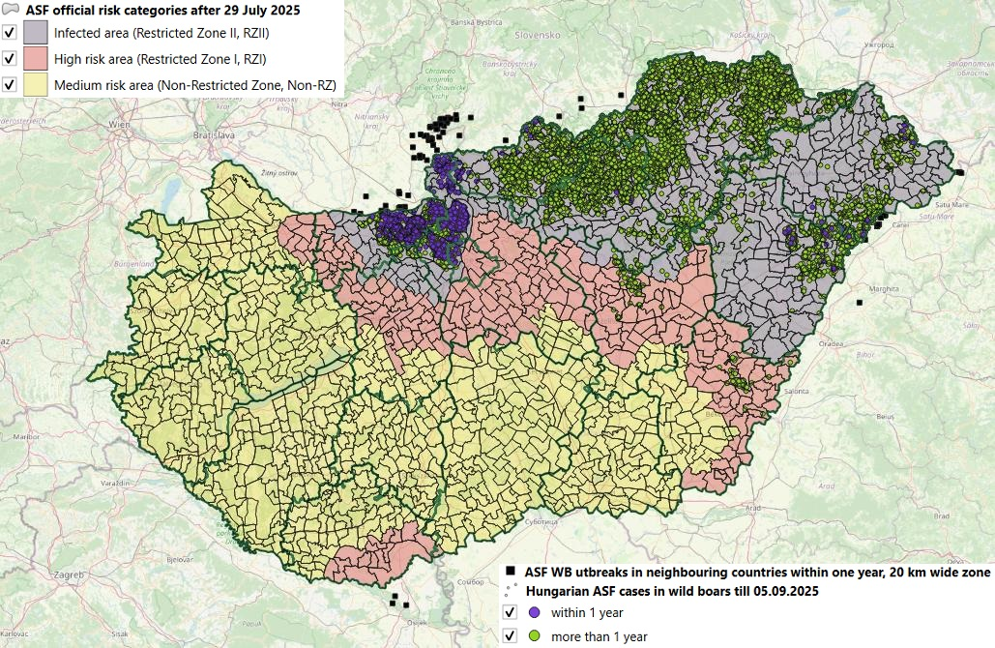
National official risk areas with all Hungarian cases in wild boar till 05.09.2025 and WB outbreaks in neighbouring countries within one year

Slide 28
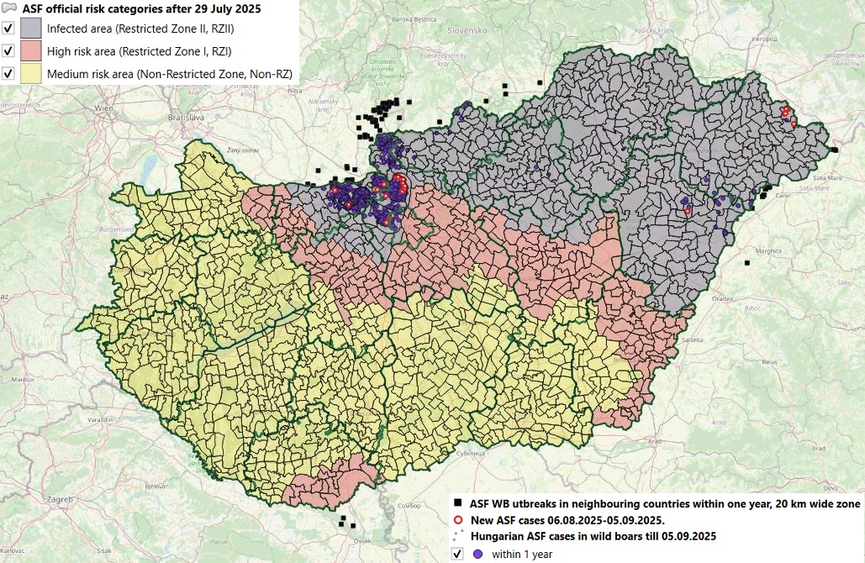
Official risk categories (status) with cases within one year highlighted for last month (as of 05.09.2025)

Slide 29
Table of all wild boar ASF cases till 12.09.2025
County | Passive surveillance |  | Active surveillance | All cases | Passive surv. %
 | Total | Dead from that
Békés | 108 | 107 | 12 | 120 | 90,00
Borsod-A-Z | 5327 | 5286 | 795 | 6122 | 87,01
Fejér | 40 | 40 | 7 | 47 | 85,11
Hajdú-Bihar | 496 | 484 | 291 | 787 | 63,02
Heves | 1909 | 1893 | 458 | 2367 | 80,65
Jász-N-K | 154 | 149 | 26 | 180 | 85,56
Komárom-E | 753 | 718 | 452 | 1205 | 62,49
Nógrád | 1130 | 1129 | 399 | 1529 | 73,90
Pest | 767 | 723 | 423 | 1190 | 64,45
Szabolcs-Sz-B | 539 | 531 | 212 | 751 | 71,77
HU total | 11223 | 11060 | 3075 | 14298 | 78,49

Slide 30
All ASF cases in wild boars by county till 12.09.2025

Slide 31
ASF cases in Hungary by hunting year, until 12.09.2025
County | Passive surveillance |  | Active surveillance | All cases | Passive surv. %
 | Total | Dead from that
2018/2019. | 563 | 553 | 98 | 661 | 85,17
2019/2020. | 2748 | 2703 | 515 | 3263 | 84,22
2020/2021. | 4500 | 4464 | 1033 | 5533 | 81,33
2021/2022. | 2171 | 2156 | 349 | 2520 | 86,15
2022/2023. | 326 | 308 | 372 | 698 | 46,70
2023/2024. | 201 | 191 | 221 | 422 | 47,63
2024/2025. | 429 | 416 | 328 | 757 | 56,67
2025/2026. (2025.09.13-ig) | 285 | 269 | 159 | 444 | 64,19
Total | 11223 | 11060 | 3075 | 14298 | 78,49

Slide 32
ASF cases in wild boars in Hungary by hunting years till 12.09.2025

Slide 33
A 2024/2025. hunting year ASF cases by counties
County | Passive surveillance |  | Active surveillance | All cases | Passive surv. %
 | Total | Dead from that
Békés | 0 | 0 | 0 | 0 | --
Borsod-A-Z | 0 | 0 | 0 | 0 | --
Fejér | 0 | 0 | 0 | 0 | --
Hajdú-Bihar | 18 | 18 | 4 | 22 | 81,82
Heves | 0 | 0 | 0 | 0 | --
Jász-N-K | 0 | 0 | 0 | 0 | --
Komárom-E | 164 | 155 (55 Pest GMU) | 188 (58Pest GMU) | 352 | 46,59
Nógrád | 23 | 23 | 10 | 33 | 69,70
Pest | 217 | 213 | 116 | 333 | 65,17
Szabolcs-Sz-B | 7 | 7 | 10 (1 HB GMU) | 17 | 41,18
Hungary total | 429 | 416 | 328 | 757 | 56,67

Slide 34
A 2025/2026. hunting year (till 12.09.2025) ASF cases by counties
County | Passive surveillance |  | Active surveillance | All cases | Passive surv. %
 | Total | Dead from that
Békés | 0 | 0 | 0 | 0 | --
Borsod-A-Z | 0 | 0 | 0 | 0 | --
Fejér | 0 | 0 | 0 | 0 | --
Hajdú-Bihar | 4 | 4 | 9 | 13 | 40,00
Heves | 0 | 0 | 2 | 2 | 0,00
Jász-N-K | 0 | 0 | 0 | 0 | --
Komárom-E | 69 | 56 (8 Pest GMU) | 66(9 Pest GMU) | 135 | 51,11
Nógrád | 24 | 24 (8 Pest GMU) | 5 (1 Pest GMU) | 29 | 82,76
Pest | 185 | 182 | 68 (1 KOM GMU) | 253 | 73,12
Szabolcs-Sz-B | 3 | 3 (2 HB GMU) | 9 | 12 | 25,00
Hungary total | 285 | 269 | 159 | 444 | 64,19

Slide 35
Quarterly distribution of ASF cases in hunting years in Hungary
8. Mach 2020: Culling is min. 150% of the shot wb in basis (2019/2020) hunting year
January 2021.:
National Action Plan for management of the wild boar population

Slide 36
Graph of ASF cases in Hungary by quarters of the hunting years

Slide 37
Conclusions that can be drawn from changes in the number of Hungarian ASF cases in wild boars
The highest number of cases occurred in the 2020/2021 hunting year, with a total of 5533 cases, followed by a steady and significant decline in ASF cases over the next three hunting year.
In the 2024/2025 hunting year, the number of ASF cases nationwide began to rise again, but this was due to a sharp increase in cases inKomárom-Esztergom County and Pest County.
In the other counties – with the exception of Nógrád County – the number of cases continued to decline. In the Nógrád county, stagnation and a slight increase can be observed in this hunting year.

Slide 38
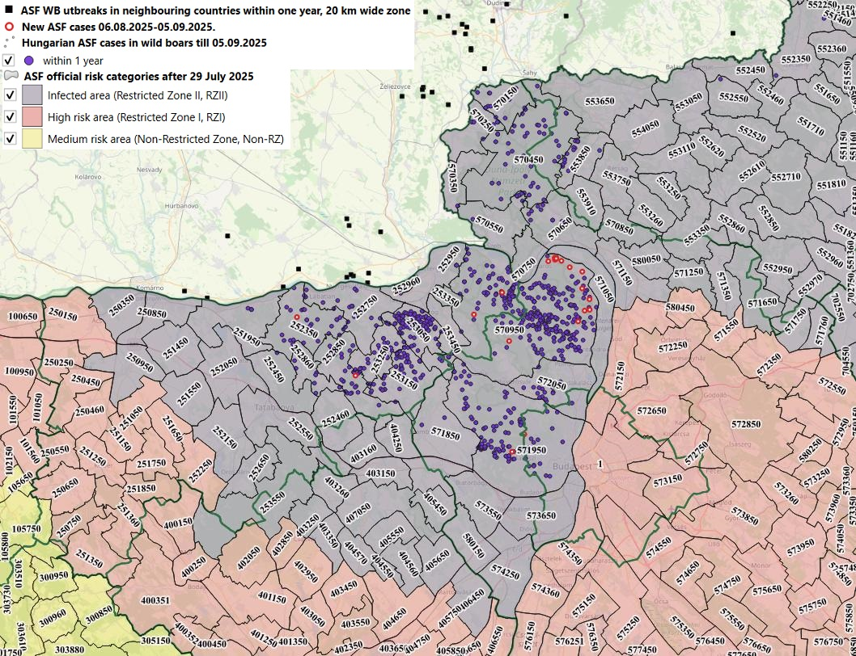
The current Hungarian epidemiological situation in parts of the country where there have been cases within one year Komárom-Esztergom and Pest counties

Slide 39
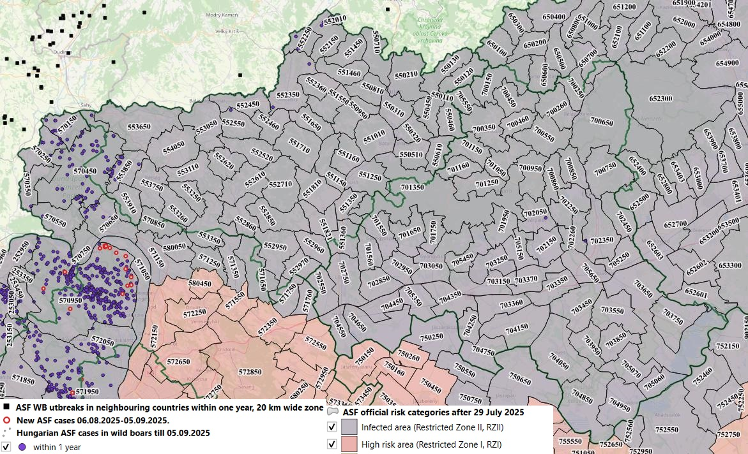
The current Hungarian epidemiological situation in parts of the country where there have been cases within one year – Nógrád and Heves county

Slide 40
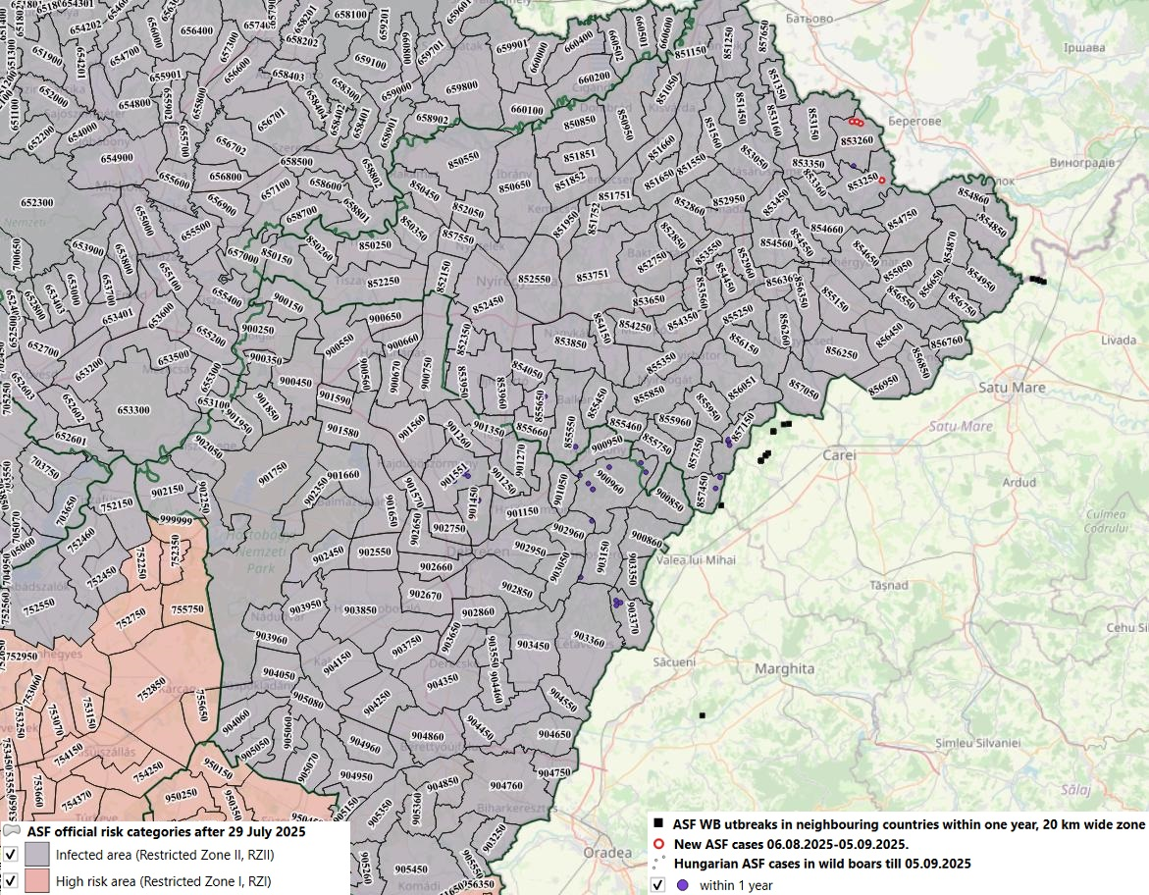
The current Hungarian epidemiological situation in parts of the country where there have been cases within one year Hajdú-Bihar and Szabolcs-Szatmár-Bereg counties

Slide 41
What is behind the decline in the number of cases?
The ASF Eradication Plan, published as an annex to Decision 2/2020 of the CVO published on 8 March 2020, amended the rules for reduction of wild boar population (diagnostic shooting for culling):
The diagnostic shooting target number is at least 150% of the number of wild boars shot during diagnostic shooting or hunting in the closed hunting year 2019/2020 as a base year in the hunting unit, for all age groups.
In January 2021, the National Action Plan for the management of wild boar population was issued and introduced, among other measures, the obligation for all hunting units to draw up a long-term plan, covering several years on the measures to be taken to achieve a maximum density of 0.5 wild boars per km² (0.5 wild boars per 100 hectares) by 28 February 2025.

Slide 42
What is behind the increase in the number of cases (1)
The minimunm target number of diagnostic shooting for culling did not apply to game management units located in the strictly restricted area (SRA)* because, following the advice of EU experts, we believed that the ASF virus alone would sufficiently reduce the population in these areas. However, this did not prove to be entirely true.
* Within the infected area, those game management units where ASF was actually confirmed
Therefore, for the 2024/2025 hunting season, we have already set a minimum target number for diagnostic shooting for culling for those belonging to the SRA.
The units belonging to the SRA in Pest County and Komárom-Esztegom County are closely related, as a significant part of the game management unit with code number 570950 in Pest county, which has numerous cases within a year, extends into Komárom-Esztegom County.

Slide 43
What is behind the increase in the number of cases (2)
The wild boar density of GMUs with a significant number of cases was above the expected 0.5 individuals/km² in almost all cases on 28 February 2025.
The exception to this is two GMUs in Komárom-Esztegom County.
However, one of them is adjacent to several GMUs with a high wild boar density and a significant number of cases.
In the other case, the estimate certainly does not correspond to reality, as 0 wild boars were estimated in February this year, but 150 wild boars were shot during the last hunting year.
It is important to note that the ASP Eradication Plan issued by Decision 5/2025 of the CVO stipulates minimum diagnostic culling targets based on wild boar density.

Slide 44
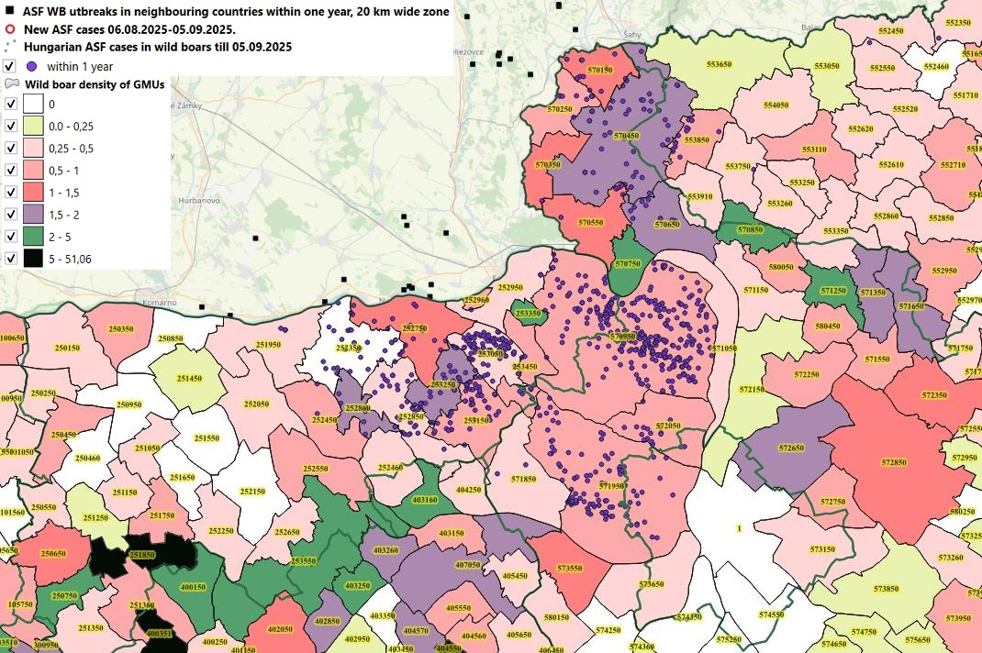
Wild boar population density and ASF cases within one year in Komárom-Esztergom and Pest counties

Slide 45
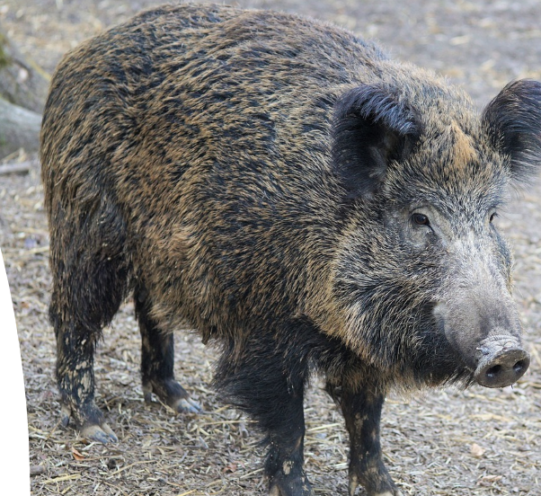
Thank you for your attention!

